Slide 1
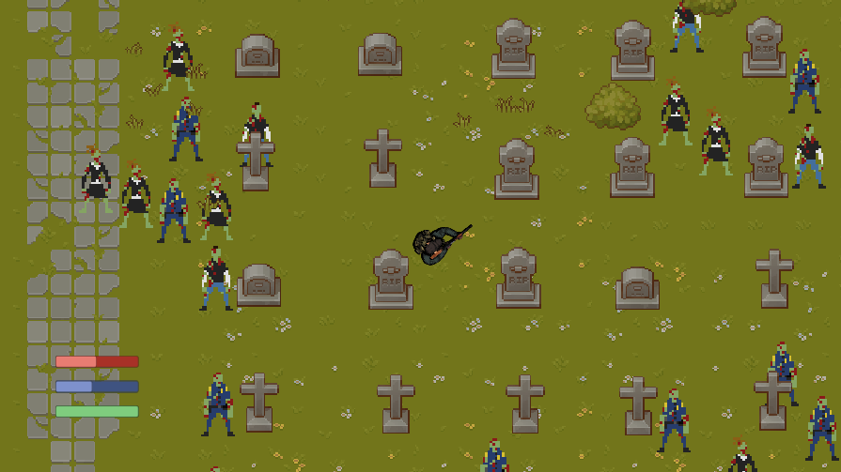
Zombie Dash
Timothy Villaraza, Michal Fitzryk, Tim Jang, Brian Yu

Slide 2



Built upon the work of Group 14
Danielle Hatten, Manuel Torres, Meaghan Ryan, Nerijus Gelezinis

Slide 3
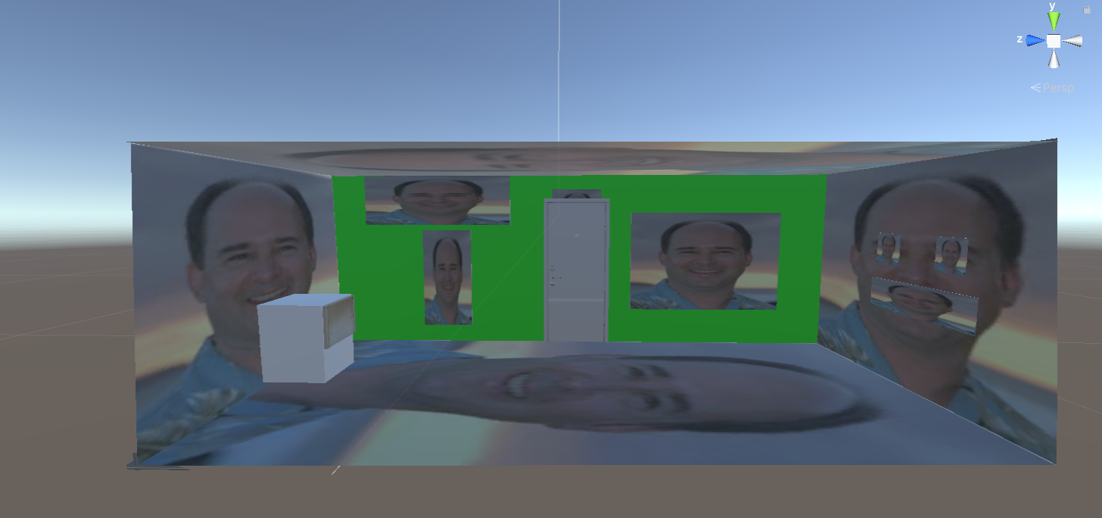
VR Escape Room

Slide 4

Why Zombie Dash
We have the same team as last semester in CS 440
We have experience in Unity
We learned the basics of 3D game development and would have liked to try our hand at a 2D game.
Zombie Dash’s project description summary was left intentionally vague which allowed room for creative freedom.

Slide 5
Stages of Development

Slide 6
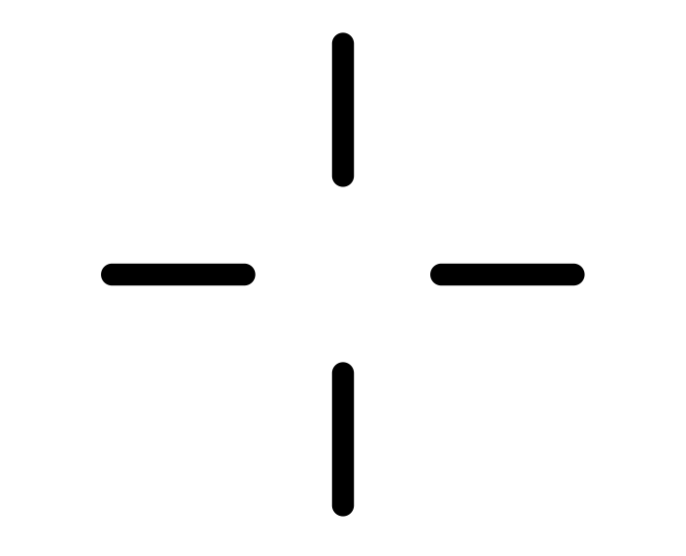
First Release
Main Features
  Aiming System
  Movement, Dash, and Camera Controls
  First level
Small Features
  Menu Functionality
  Player Sprite

Slide 7


Second Release
Main Features
  Test enemies given zombie sprites and health
  Zombie spawning, variants and animations
  Player Health
  Objective gameplay implemented
  Sound Effects
  Health Packs
Small Changes
  Volume Slider
  Full auto gun

Slide 8

Third Release
Main Features
  Implemented level system
Small Features
  Environment
  Borders
Fixes
  Collision (npc, map ,etc)

Slide 9
Workflow

Slide 10




Software Development Practices
Pair Programming
Planning Poker (Fibonacci Scale)
Pomodoro Technique
XP Values (Respect, Communication)

Slide 11

Tech Stack
GitHub
  GitHub Desktop
Jira
  Sprint cycle management
Unity
  C#
Visual Studio IDE
  Unity integration

Slide 12

Development Cycle
Protected main branch
Pull request template
Merging only allowed to main branch after code review from at least one other person.
Weekly Sprints

Slide 13
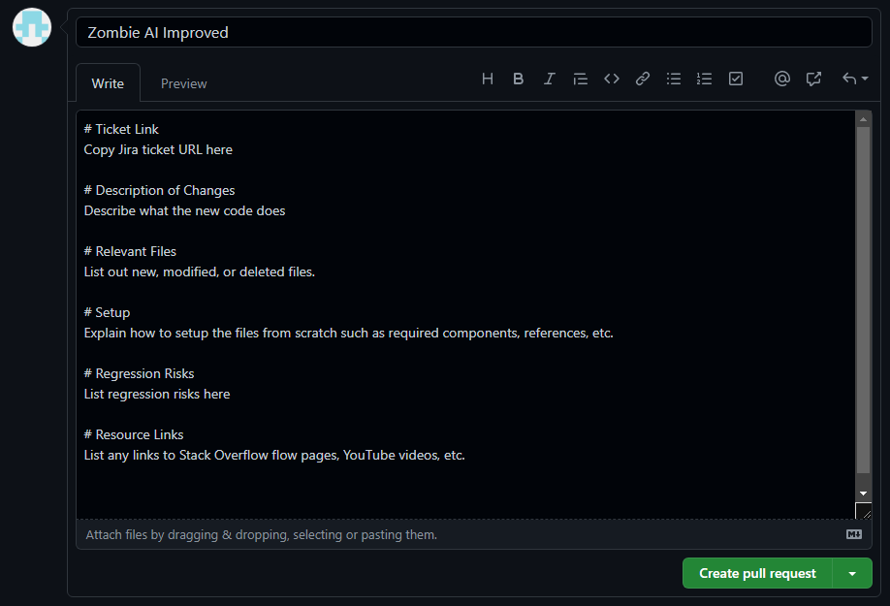
Pull Request Template

Slide 14
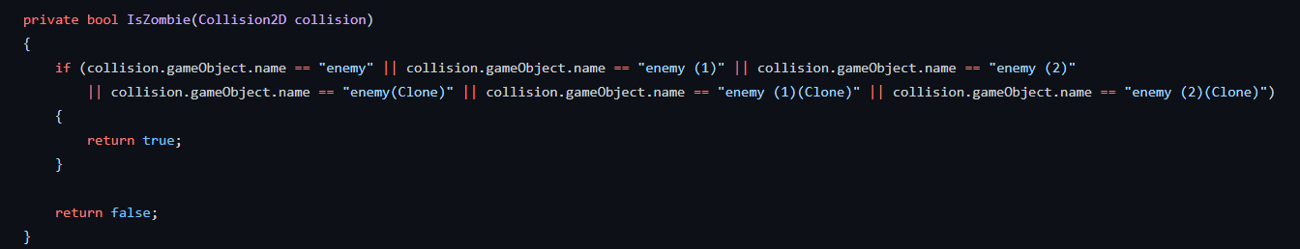
Before Review
Notes:
Peer Review

Slide 15
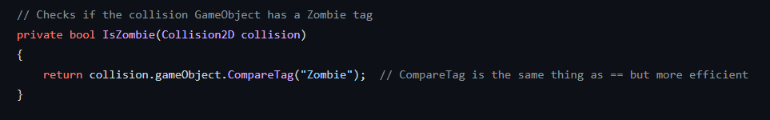
After Review

Slide 16
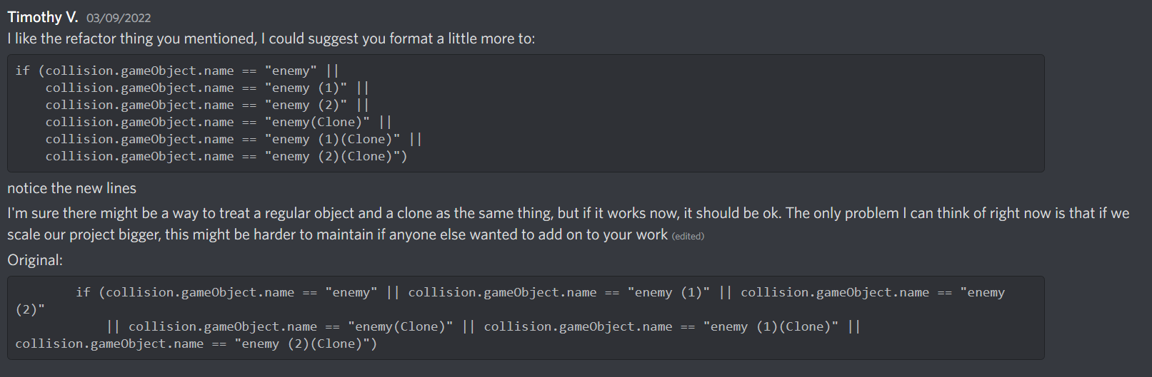

Slide 17
Project Demonstration

